Slide 1
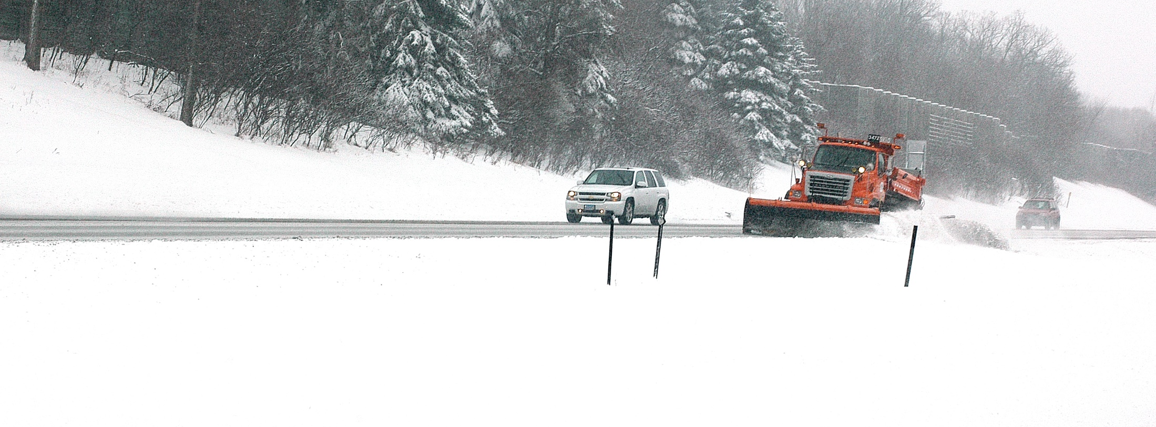
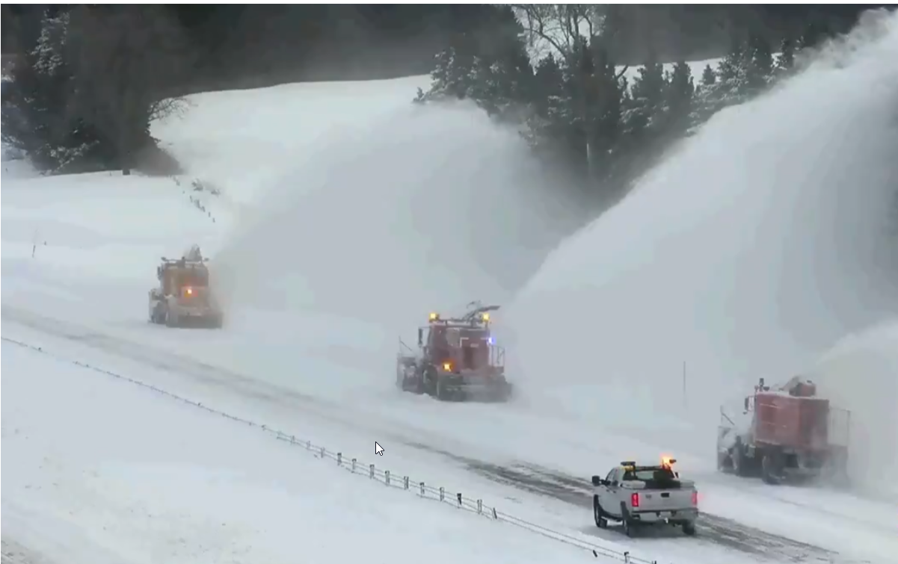
Snow & Ice Event/Bare Lane Training
2019-2020

Slide 2
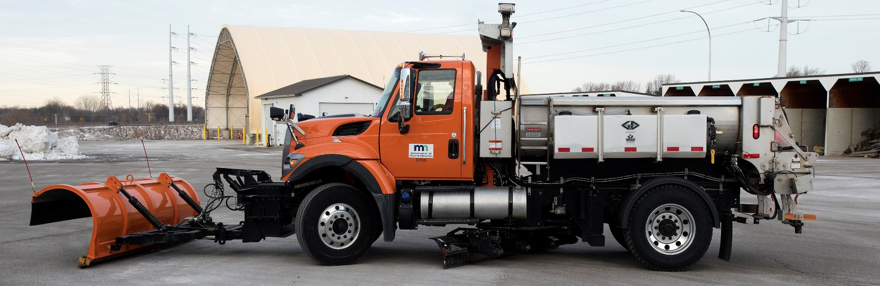
Event
A winter weather occurrence that consumes resources necessary to prevent, minimize or regain the loss of bare lanes.

Slide 3
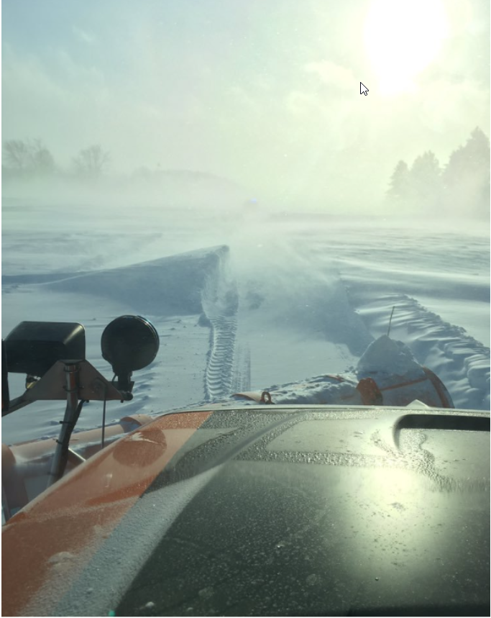
Winter Weather Occurrence
Examples
Freezing rain/drizzle
Sleet
Snow
Drifting/blowing snow
Frost
Ice/black ice
Refreeze
Or any combination

Slide 4
Resources Consumed
Material - Usage of salt brine, sand, salt, and other chemicals will trigger an event. (except road patrol and anti-icing)
Equipment - Usage of plows, wings, underbodys, and sanders will trigger an event. Use of plow trucks alone in checking of road conditions is not considered a resource.
Labor - A resource provided that either materials or equipment are used.
Correctly record time, equipment, materials within 24 hrs of shift end.
Notes:
Note – Class 33 & 35 have changed from hours to miles.

Slide 5
Prevent, Minimize, or Regain
Prevent - Usage of resources before or during the event such as anti-icing, or the application of chemicals to prevent the loss of bare lanes.
Minimize - Usage of resources/chemicals to reduce the effects or impact of bare lanes lost.
Regain - Process/resources needed to regain the loss of bare lanes.

Slide 6
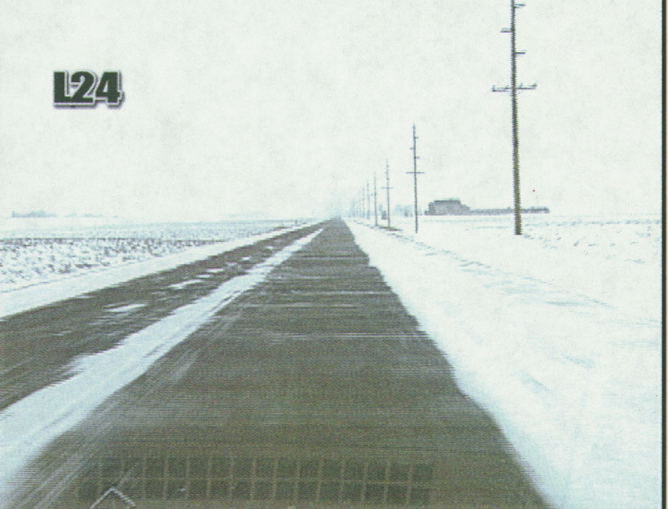

Bare Lane
Center stripe and fog lines can be covered with ice and snow, but travel speeds can not be impacted.
95% of Wheel tracks and everything in between must be free of snow and ice.
Shoulder and ramps are not included.

Slide 7
95% Bare Lane Example
Can have compaction between the outer edges of wheel paths through small towns as long as travel speed is not impacted, and the total of these locations do not exceed 5% of the route.
If at least 95% of the route meets bare lane condition, but travel speed is impacted because of intermittent drifts or ice, this does not meet the bare lane measure.

Slide 8
Event
BEGIN
EVENT
END
BARE LANE REGAIN TIME
LOST BARE
LANE
REGAIN BARE
LANE
TIME IN HOURS
*RECORD IN 1\2 HOUR INCREMENTS
* USE REGULAR TIME - NOT 24-HOUR CLOCK
Notes:
The most important numbers here are from the time the event ends how long did it take to regain the segment.

Slide 9
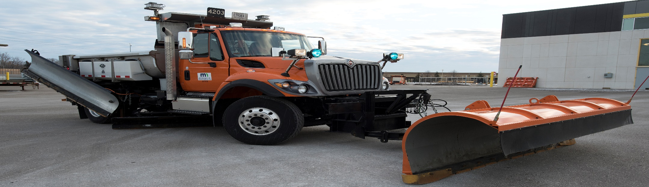
Event “Six Hour Rule”
If an event stops and restarts after six hours, it is then considered a new event.
If an event stops and restarts in under 6 hrs it is a continuation of the 1st event.

Slide 10
Reporting Bare Lane Regain
Must record bare lane regain in 1st event before you can start a second event.
If bare lanes have not been regained before the start of a new event, all non-regained routes must be set to regain at start of new event.
  Event Start and Lane Loss will be same for new event.
Notes:
Must record Bare Lane Regain in the 1st event before you can start a second event provided that the time between the 1st and 2nd events is greater then 6 hours.
Bare lanes can and may be lost and regained several times during an event.

Slide 11
Event/Bare Lane Reporting
Events are recorded even if bare lanes have not been lost, provided resources have been used.
Use best judgment when recording start/end of an event and when recording bare lanes lost/regained.
Use weather reports - RWIS – MDSS - Patrol Dispatch – Road Patrol or your Supervisor to help with this task.
Must record info in RCA within 24 hours of shift ending.

Slide 12
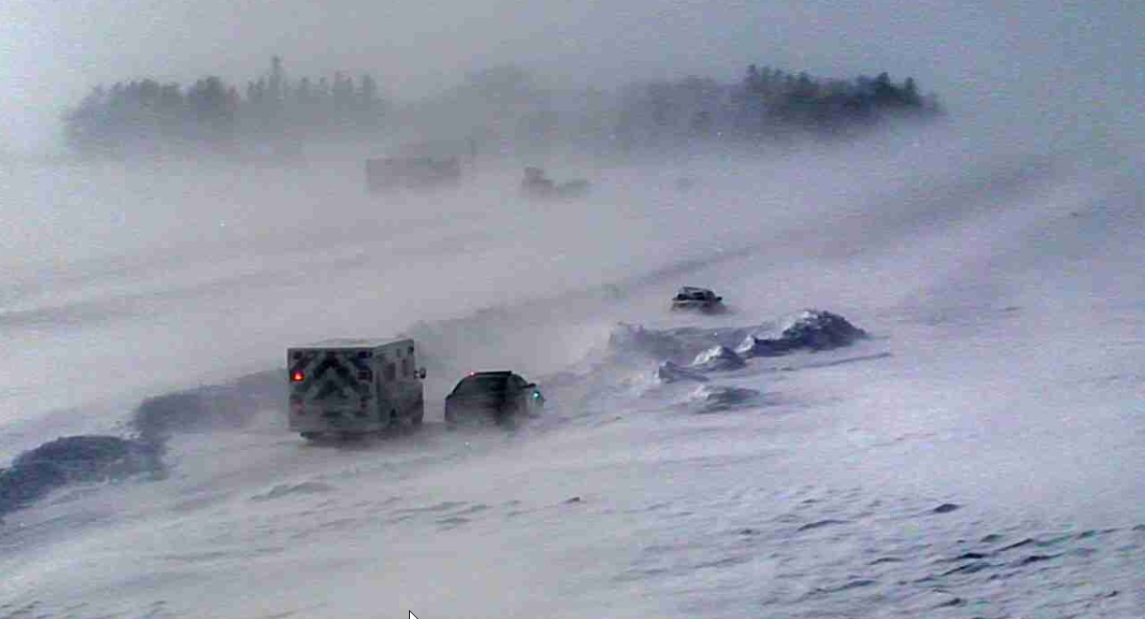
Thank you and Have a Save Winter Season!

